Slide 1
Before you begin…
Make sure you have completed the following:
Read “What is Plagiarism”
2. Turn in the Create a Quiz assignment into D2L

Slide 2
Plagiarism
CATT Hybrid
Tara Chandler: Assessment Module Instructor

Slide 3
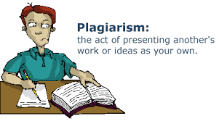
What is Plagiarism?
There are several definitions.
In general, it is when someone uses ideas or words from another person and doesn’t cite where those ideas or words are from.

Slide 4
Plagiarism
It is more prevalent now than it used to be.
Cultures (outside of the U.S. and U.K.) have various attitudes towards plagiarism and perhaps even define it in different ways.
There are examples from Asian, Middle Eastern, and African countries where students were expected to copy since it was a sign of respect and/or knowledge was seen as the property of everyone (collectivism) rather than of an individual.
(Yusof, 2009)

Slide 5
Plagiarism
In the U.S., U.K. and other Western cultures, plagiarism is a very serious offense.
For students who are now learning English as an L2, this might be a new concept for them.
If students are going to read and write in English, this is an important cultural concept for them to understand about using information in English.

Slide 6
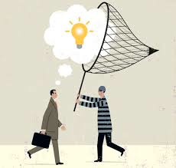
Plagiarism and Assessment
Plagiarism is tied closely together with both the validity and reliability of an assessment.

Slide 7
Plagiarism
Validity
Reliability
Does the assessment measure what we really want to measure?
If students are copying other people’s ideas, are the teachers measuring what the students know?
Is all work being consistently marked to the same standard?
If some students are using someone else’s ideas, (and they are better/ more complex, etc.) is that being consistently (and fairly) marked against the students who are using their own ideas?

Slide 8
Plagiarism
It is our responsibility to…
Teach students what plagiarism is and how to avoid it.
Create assessments where students are not given too much opportunity for cheating/plagiarism.
Follow up with consequences as necessary if students do plagiarize.

Slide 9
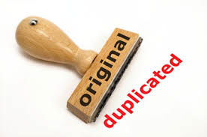
Plagiarism…
can also be an indication that students don’t have the ability to use English well enough to form their own ideas in their L2. This can be one reason why students turn to plagiarism.

Slide 10
Plagiarism
It is better (and leads to higher validity) if students use translanguaging instead of plagiarizing.
In other words, letting students use Portuguese in order to accurately express their content knowledge is more important than using English all of the time.

Slide 11
Summing it up…
Stop and consider the answers to the following questions:
What is plagiarism?
Why do some students turn to plagiarism?
What is the teacher’s responsibility related to plagiarism?

